Slide 1
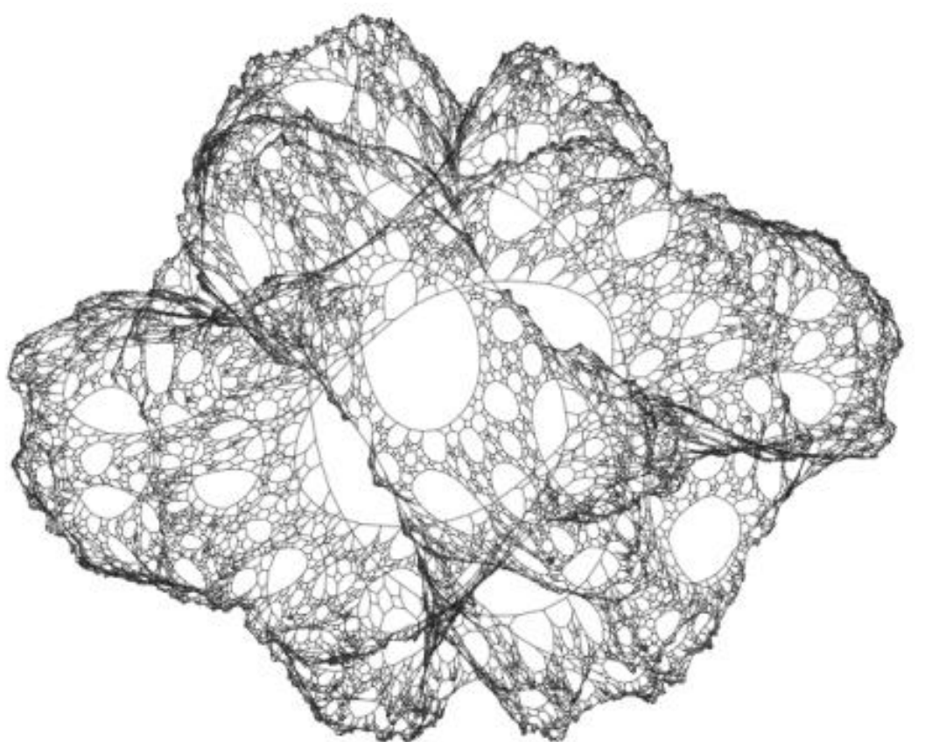
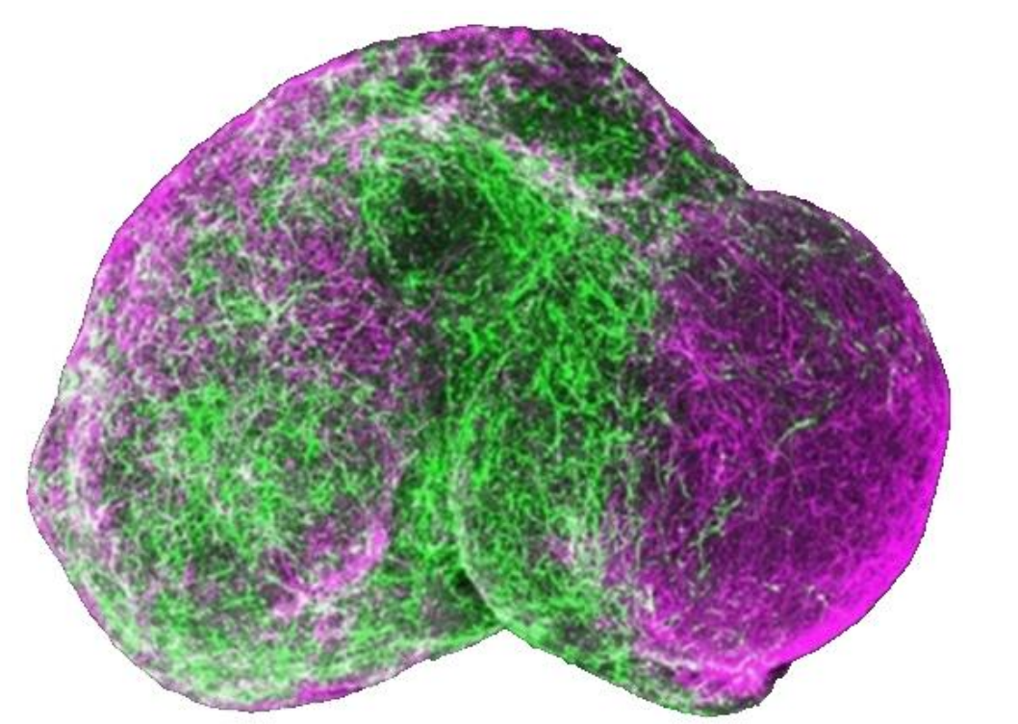
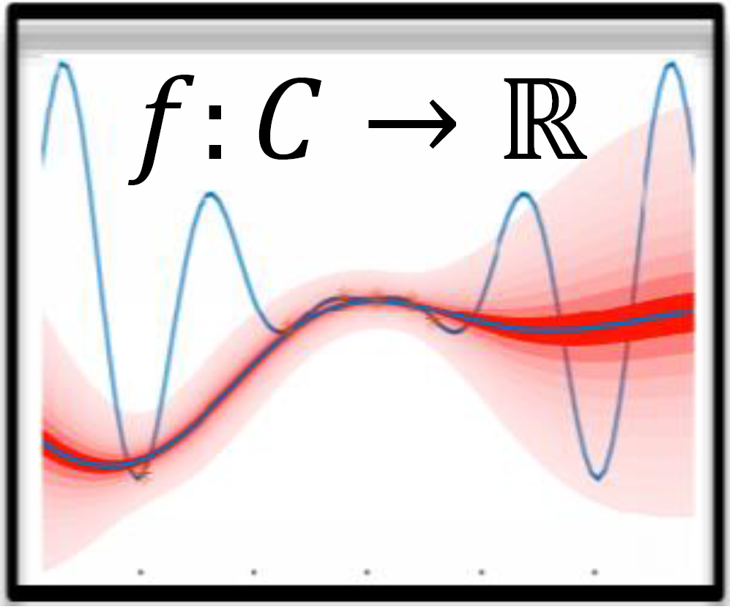
+
Institute of Software Technology
Learning and Predicting the Performance of Configurable Software Systems
Sampling
Seminar Advanced Software Engineering, Lion Wagner
Learning
Predicting
08.07.2019

Slide 2
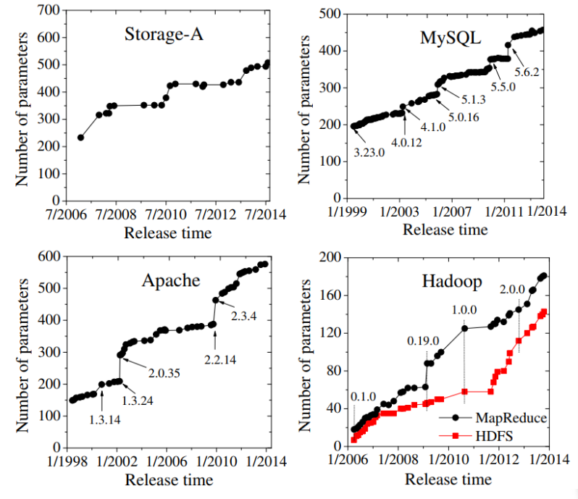

Motivation: More Configurations Options
Hey, You Have Given Me Too Many Knobs! [5]: Programs are getting increasingly more configuration parameters.
Notes:
Todays programs are getting more configurable
apache… filter configuration, number of threads , thread spawning
Good for stakeholders and customers
Enables tailoring for specific requirements

Slide 3
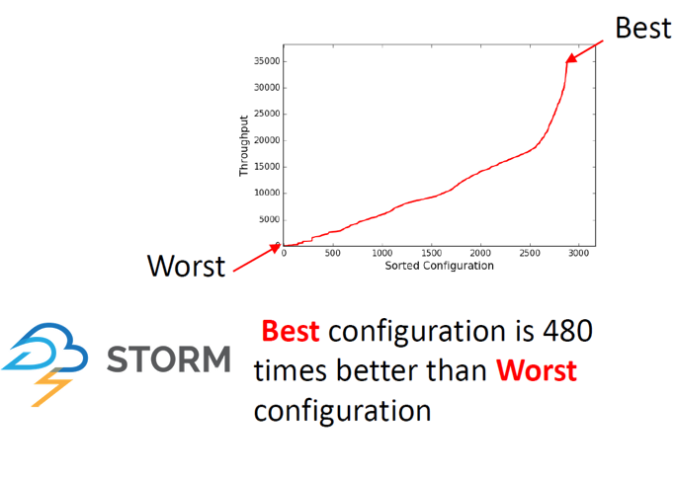
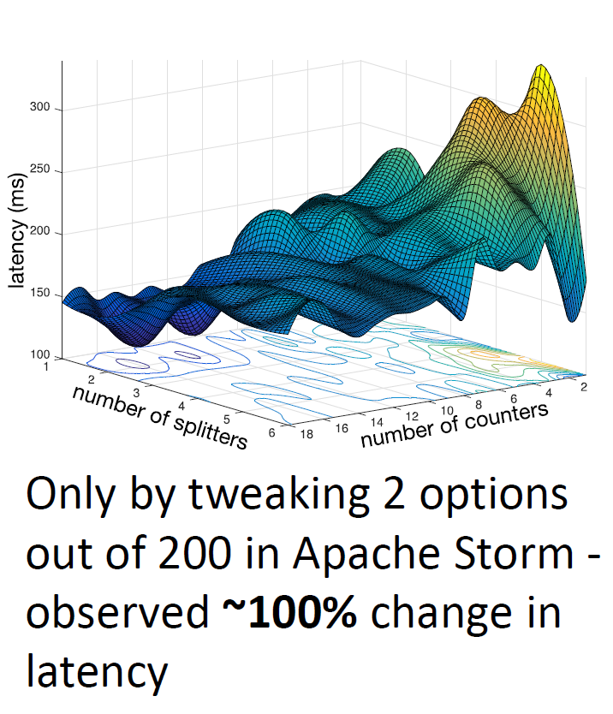
Motivation: Configuration matters!
But: Bad configurations can have a big impact on performance:
More Configurations
More Possibilities of Performance Influences
Performance prediction is hard.
Notes:
Greate performance diffrences between configurations of the same system.
Change of 1 option can make a huge difference
-> hard to predict

Slide 4

Motivation: Why should we care?
(Near) Optimal configurations
Good default configurations
Implementation problems
Proof of a good average performance
We are looking for:
Can’t we just measure every configuration?
Notes:
Why should we care?

Slide 5

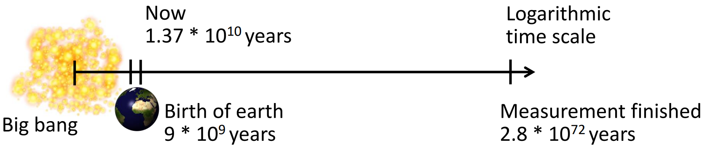
The Problem: Examples of N. Siegmund et al. [1,7]
Have a look at Berkley DB (C):
19 features
2560 configurations
426h (~18d) for brute force testing
Let’s go larger!
with SQLite!
77 features
3∙10⁷⁷ configurations
Assumption: 1 measurement = 5min (compilation + benchmark)
Notes:
Berkley DB ~ 10min per config.
Literally not doable for sqlite
Actual problem appears on this slide

Slide 6
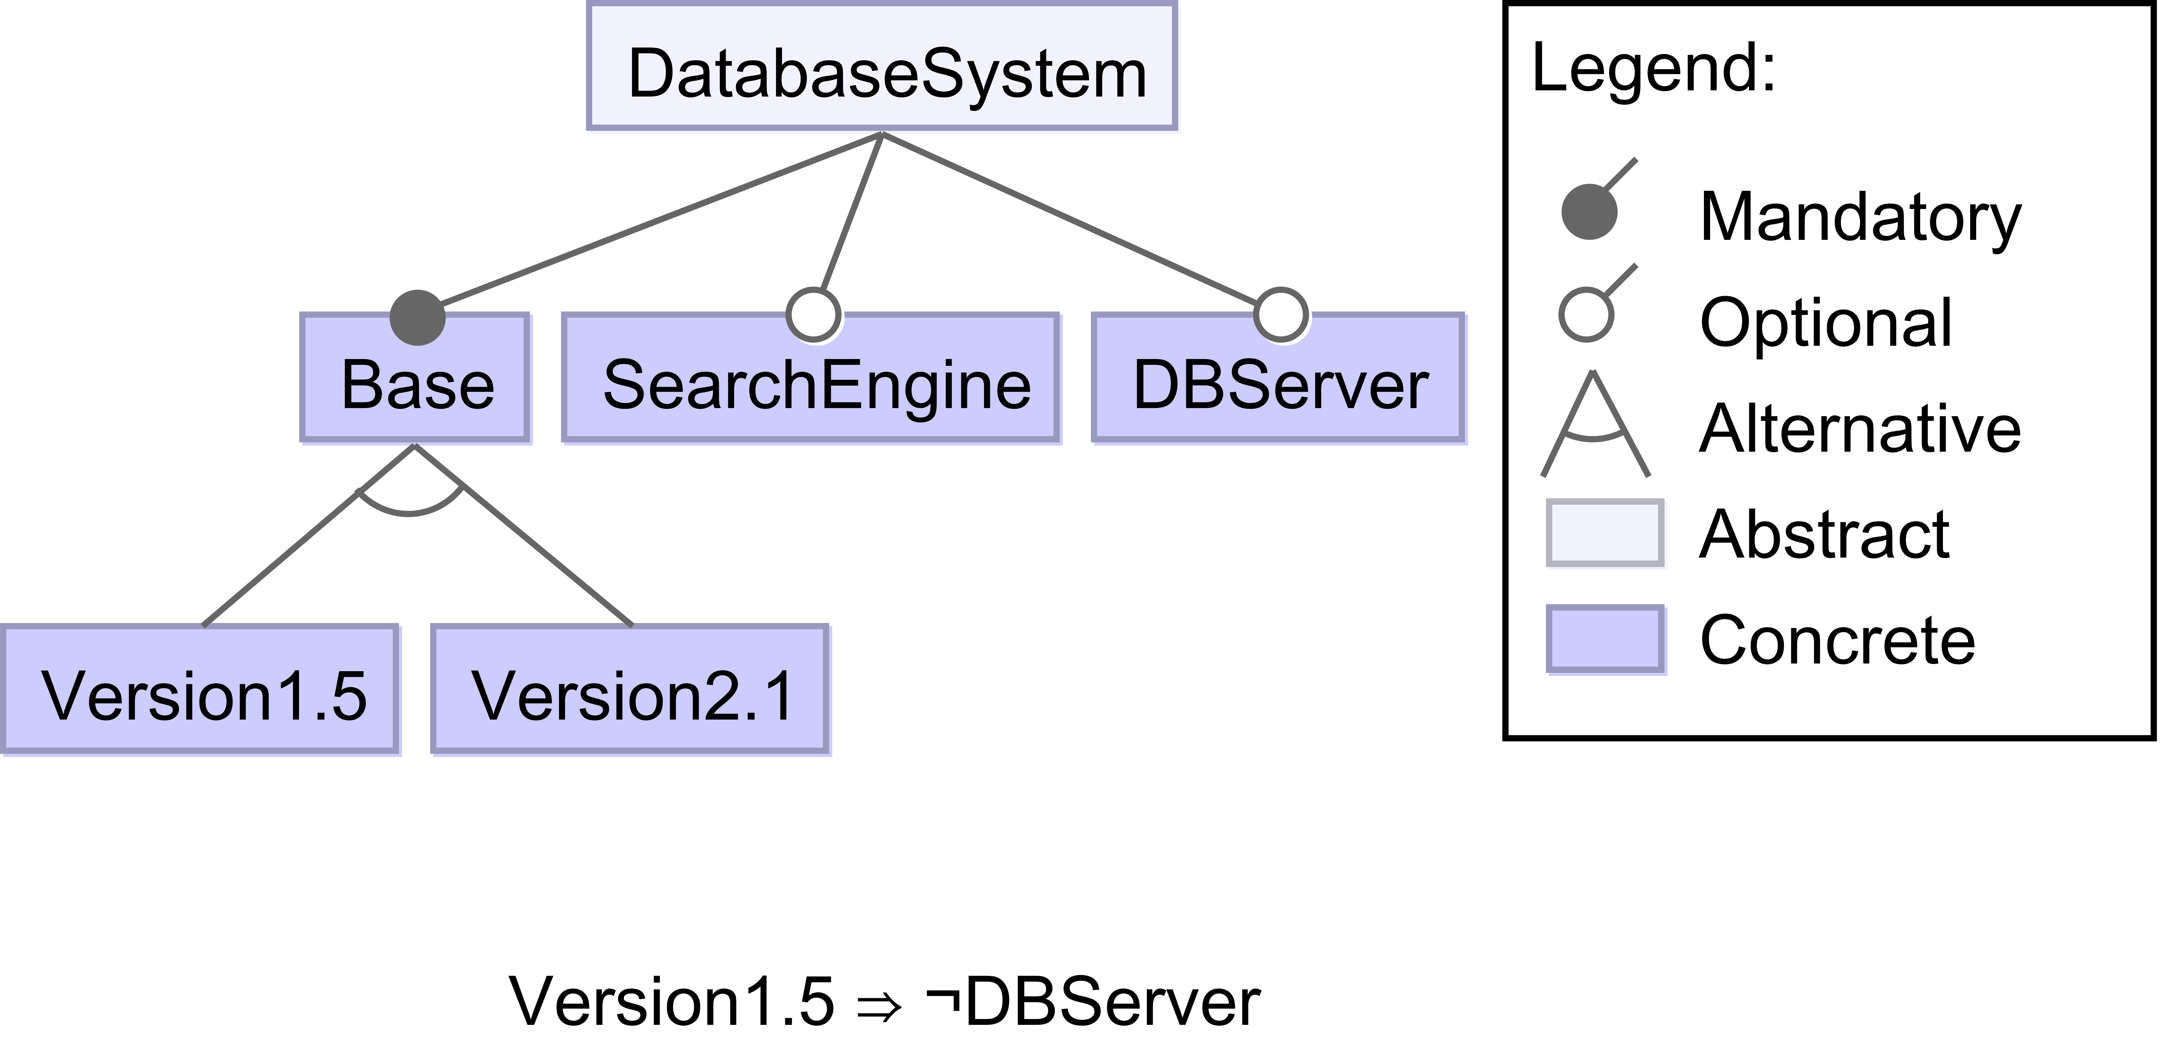
The Problem: Exponential Configuration Space
Presentation of valid configurations as Feature Model
⇔
Valid = Base ∧ (Version1.5 ⊕ Version2.1) ∧ (Version1.5 ⇒ ¬DBServer)
Example: Default = {Base = 1, Version2.1 = 1, SearchEngine = 0, DBServer = 0}
⇒ all valid configurations (Configuration Space) ∈ O(2^{#options})
Notes:
self explainatory feature model
Equivalent to a logical expression (with help of annotations)
How many valid assignments? => O(n^2)

Slide 7
Performance Learning and Prediction

Slide 8
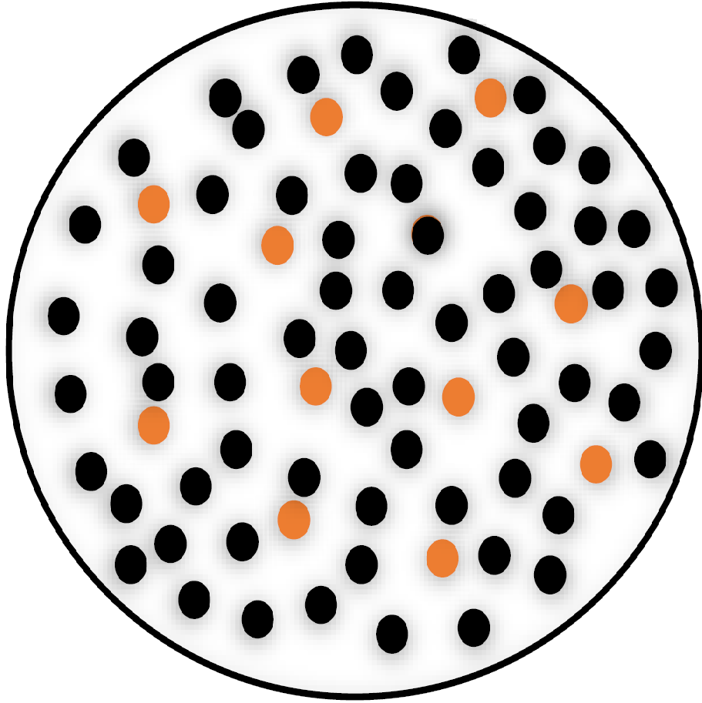
The General Approach
Sampling
Learning
Prediction
Optimization
Analysis
Presented Techniques:
Brute Force
Automated Feature Interaction Detection
Projective Sampling
Notes:
General approach
Sampling -> reducing/filtering of the exponential configuration space (main problem)
Learning -> application of machine learning techniques
Brute force not feasible
AFID a non machine learning approach
Different sampling strategies

Slide 9
Automated Feature Interaction Detection
Goal: Assign a performance influence value ∏ to each feature (interaction).
A simplified example:
System S w/o features
∏(S) = 100
System S with a
∏(Sxa) = 110
System S with b
∏(Sxb) = 95
System S with a and b
∏(Sxaxb) = 103
∏(Sxa) = ∏(S) + ∏(a)
⇒ ∏(a) = 10
∏(b) = -5
∏(Sxaxb) = ∏(S) + ∏(a) + ∏(b) + ∏(a#b)
⇒ ∏(a#b) = -2
Notes:
b speeds up a aswell -> Sxaxb = 103 \= 105

Slide 10

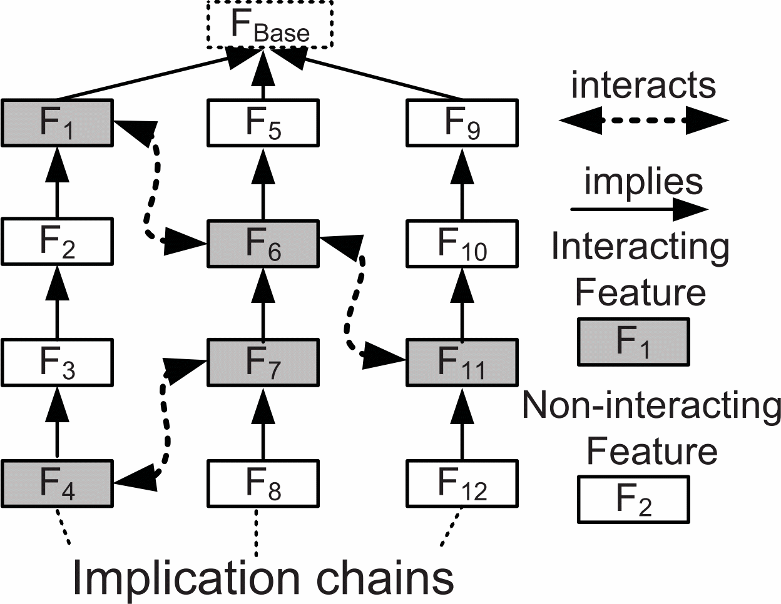
Automated Feature Interaction Detection Cont'd
Step 1: Find interacting features
∏(mi(f)×f)
∏(max(f)×f)
Step 2: Measure feature interaction impact
Pair-Wise Heuristic
Measure Performance Impact
Higher-Order Heuristic
Hot-Spot Heuristic
O(n²) Pairs
Notes:
Assign a performance influence value
2 steps:
Find interacting features
Measure interactions based on heuristics and implications chains

Slide 11
Automated Feature Interaction Detection Cont'd
Step 1: Find interacting features
for each feature f do…
∏(f)=∏(min(f)×f)-∏(min(f))
∏(min(f)×f)
∏(max(f)×f)
yes
≈ equal?
no
Mark f as interactive
Step 2: Measure feature interaction impact
Pair-Wise Heuristic
Measure Performance Impact
Higher-Order Heuristic
Hot-Spot Heuristic
O(n²) Pairs
Notes:
Assign a performance influence value
2 steps:
Find interacting features
Measure interactions based on heuristics and implications chains

Slide 12


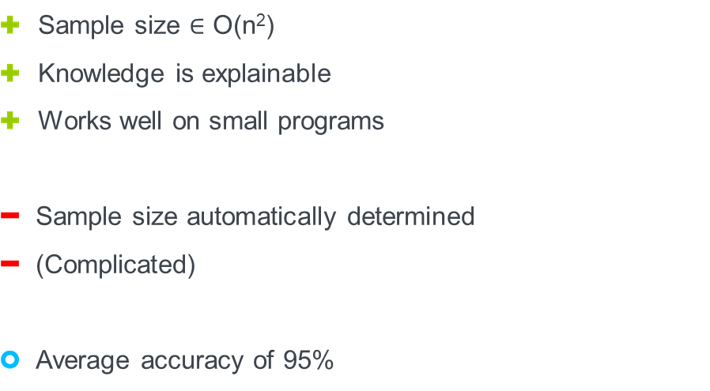

Automated Feature Interaction Detection
Advantages/Disadvantages
Sample size $∈$ O(n²)
Knowledge is explainable
Works well on small programs
Sample size automatically determined
(Complicated)
Average accuracy of 95%
Further details in: N. Siegmund et al.: Predicting performance via automated feature interaction detection. [1]

Slide 13
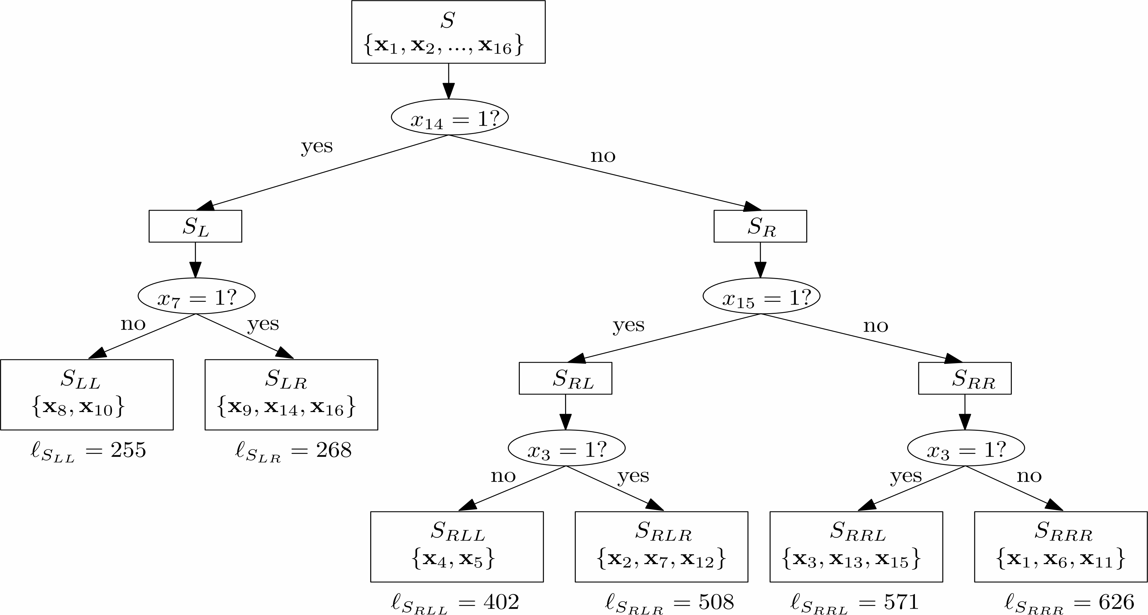
Classification and Regression Trees (CART)
Set of data points D + Evaluation Function + balancing Heuristic
Configurations are classified by thier performance values

Slide 14
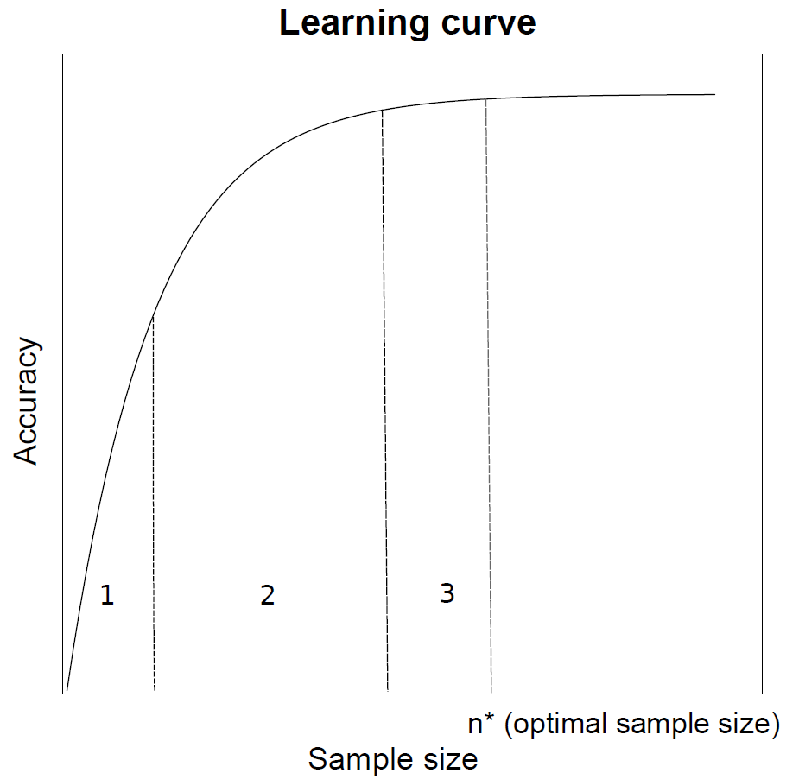
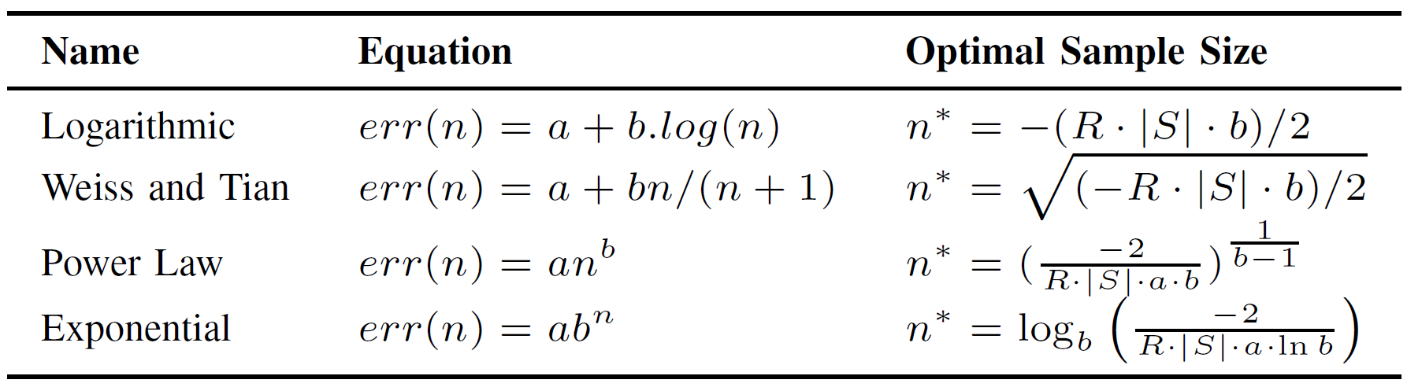
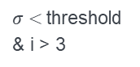


Projective Sampling
Tires to find an optimal, cost efficient sample size with curve fitting
Iterative process
Function fitting
Substitute $err(n)$ with function and find minimum $=n^{∗}$
$σ<$threshold & i > 3
Start
i =1
Measure another random configurations
Insert into a Learning Algorithm
Evaluate mean error $σ$ of Predictor
Evaluate mean error 𝜎 of Predictor
Add point (i,1-$σ$) to learning curve
Add point (i,1-𝜎) to learning curve
i +=1
$$TotalCost\left(n\right)=2n+err(n)∙\left|S\right|∙R$$
Build optimal
sized sample set for prediction
Notes:
Takes advantage of knowledge on learning curves
Initial sample set is generated -> generates first part of learning curve
Curve fitting
Substitution and calculation of the optimal sample size

Slide 15
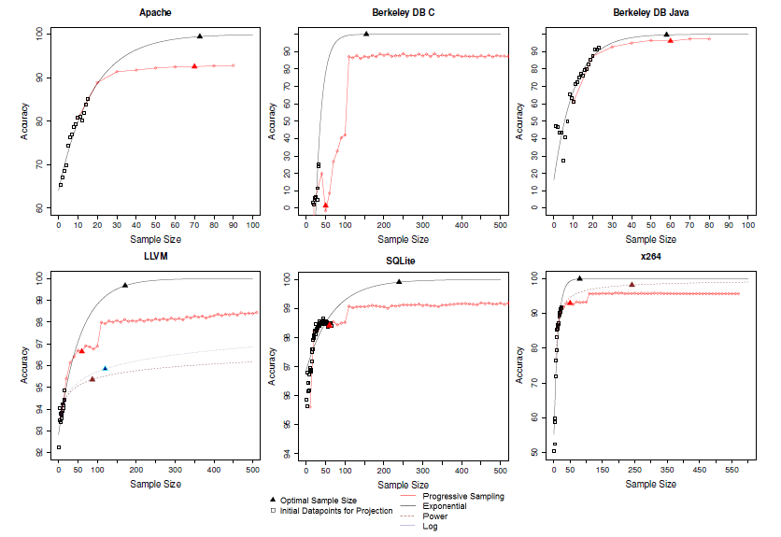
Projective Sampling: Learning Curve Examples

Slide 16
Progressive Sampling
Advantages/Disadvantages
also considers sampling cost
up to 99% accuracy
can use a significantly larger sample then other approaches
initial sample generation has high influence on accuracy
Further details in: A. Sarkar et al.: Cost-Efficient Sampling for Performance Prediction of Configurable Systems. [3]

Slide 17
Other Sampling Techniques
Random Sampling, J. Gou et al. [2]
Chose random sample (no fixed size)
Whole sample is measured
Put Data into Learning Algorithm
Clustering based Sampling, V. Nair, et al. [4]
Cluster Configurations (e.g. by distance)
Measure one Configuration of each leaf cluster
Put Data into Learning Algorithm
Progressive Sampling, A. Sarkar et al. [3]
Insert configurations stepwise into a Learning Process
Let this sample grow until the learning rate stagnates or the cost function reaches a minimum.

Slide 18
Conclusion
Main Problem: Reduction/Filtering of an exponential Configuration Space
Solved by using good sampling techniques
Learning with typical machine learning strategies
Sampling
Random
Projective
Learning
CART
Neural Network
Cluster Based
…
Transfer Learning
…
Progressive
Prediction
Optimization
Analysis
A good balance between the sample size and accuracy is key
There is no perfect solution

Slide 19
References
[1] N. Siegmund et al.: Predicting performance via automated feature interaction detection. In Proc. of ICSE, pages 167-177. IEEE, 2012.
[2] J. Guo et al.: Variability aware performance prediction: A statistical learning approach. Automated Software Engineering (ASE), 2013 IEEE/ACM 28th International Conference, pages 301-311. IEEE Press, 2013
[3] A. Sarkar et al.: Cost-Efficient Sampling for Performance Prediction of Configurable Systems. 30th IEEE/ACM International Conference on Automated Software Engineering (ASE), pages 342-352, 2015
[4] V. Nair, et al.: Faster discovery of faster system configurations with spectral learning. CoRR , 2017
[5] T. Xu et al.: Hey, You Have Given Me Too Many Knobs! ESEC/FSE 2015 Proceedings of the 2015 10th Joint Meeting on Foundations of Software Engineering, pages 307-319

Slide 20
References
[6] N. Siegmund et al.: Challenges and Insights from Optimizing Configurable Software Systems.VAMOS 2019, 2019.
[7] C. Kästner et al.: Software Product Line Engineering, Bauhaus-University Weimar, 2018
Figures and pictures taken either from Creative Commons or the papers above.

